Slide 1


APPLICATION OF GEOGRAPHY ELECTRICAL NETWORK ANALYSIS
ASSIGNMENT-4
Chhattisgarh Swami
Vivekananda Technical
University
PRESENTED BY Madhurima Rawat ROLL NO-$300012821042$ DATASCIENCE(CSE)

Slide 2
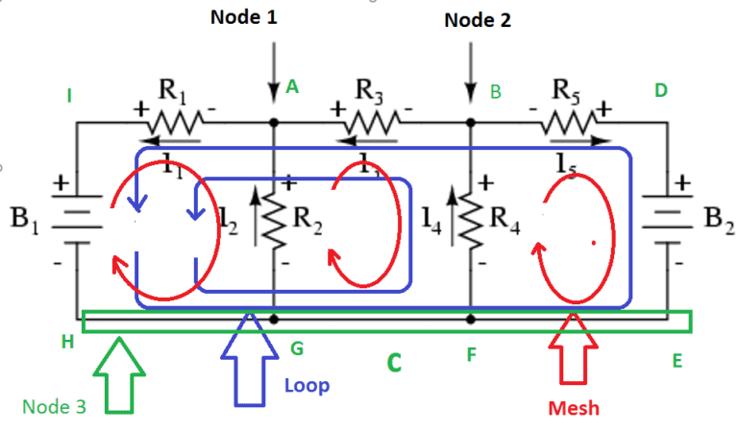
GEOGRAPHY ELECTRICAL NETWORK ANALYSIS
An electrical network is an interconnection of electrical components (e.g., batteries, resistors, inductors, capacitors, switches, transistors) or a model of such an interconnection, consisting of electrical elements(e.g., voltage sources, current sources, resistances, inductances, capacitances).
A connected acyclic graph called tree was implemented
by G.Kirchhoff in 1847 and he used graph theoretical
concept in the calculation of currents and voltages in networks and was later improved by J.C.Maxwell in 1892.

Slide 3
DEFINITIONS
Network: It is an interconnection of electrical components like resistors, capacitors, inductors, diodes, transistors, voltage sources, current sources, switches and loads but not closed.
Circuit: A closed network is a called a Circuit.
Walk: A Walk is an alternating sequence of vertices and edges which starts with a vertex and ends with a vertex and each edge ei joins the vertices vi-1 and vi.
Cycle: A closed path is called a cycle.
Eulerian Graph: A graph is said to be Eulerian if it covers all the edges of the graph.
KVL: It is the abbreviated form of Kirchoff’s Voltage Law. It states that the algebraic sum voltages in a circuit is always zero.
KCL: It is the abbreviated form of Kirchoff’s Current Law. It states that the algebraic sum currents in a junction in a circuit is always zero.

Slide 4
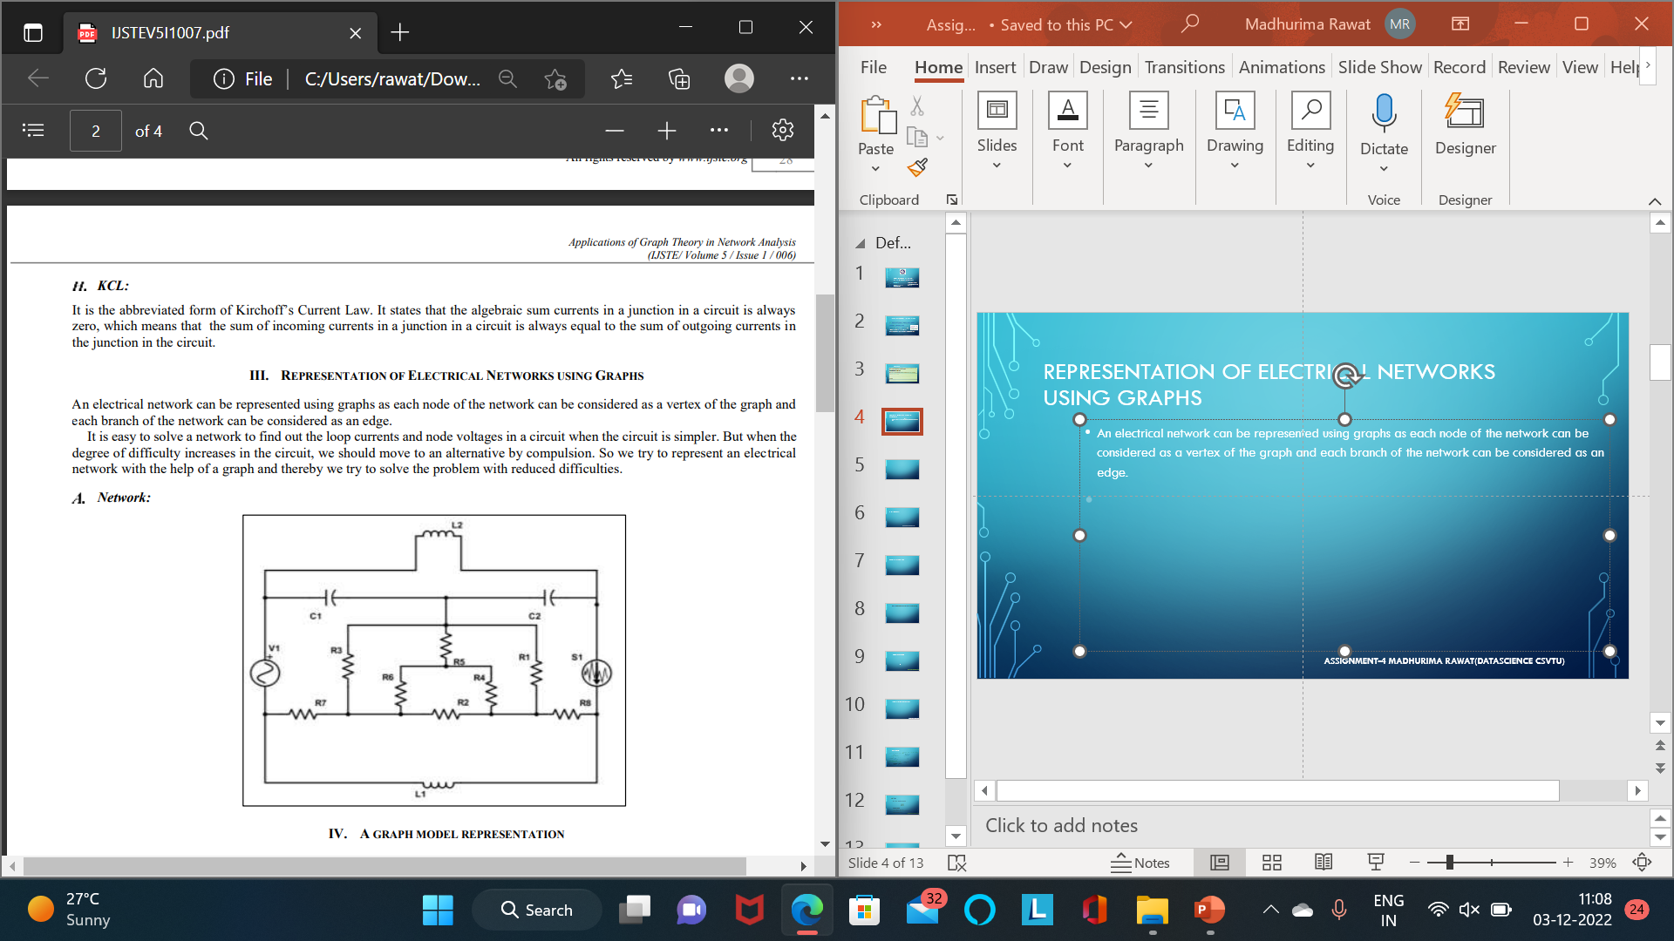
REPRESENTATION OF ELECTRICAL NETWORKS USING GRAPHS
An electrical network can be represented using graphs as each node of the network can be considered as a vertex of the graph and each branch of the network can be considered as an edge.

Slide 5
A GRAPH MODEL REPRESENTATION
It is easy to solve a network to find out the loop currents and node voltages in a circuit when the circuit is simpler. But when the degree of difficulty increases in the circuit, we should move to an alternative by compulsion.
So we try to represent an electrical network with the help of a graph and thereby we try to solve the problem with reduced difficulties.
A graph model is used to represent a network by using the vertices and edges that cover the entire network. Given below is the graph model of the network shown above.

Slide 6
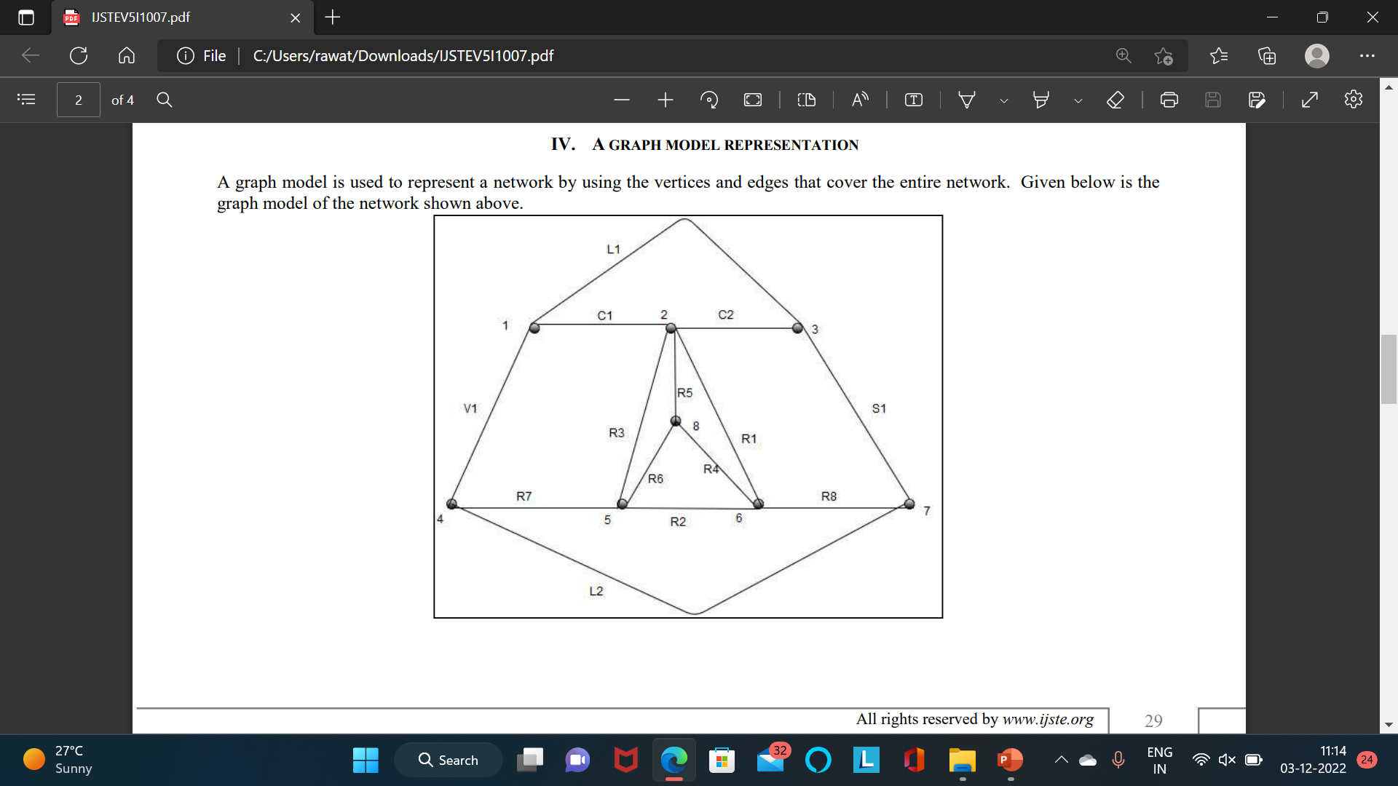
GRAPH MODEL

Slide 7
Graph Theory Network Analysis
To analyse a network means to find current through any branch or voltage across any branch.
We can analyse given network using Graph Theory Network
Analysis by relating branch currents and loop currents or branch voltages and node voltages (across tree branches).

Slide 8
Relationship between Branch Currents and Loop Currents:
Let [I_{b}] represents branch current matrix and [I_{L}] represents loop current matrix, then we can relate branch currents and loop currents as,
where [B^{T}] is the transpose of fundamental circuit matrix [B].

Slide 9
Coding implementation in python
# Python program for
# validation of a graph
# import dictionary for graph
from collections import defaultdict
# function for adding edge to graph
graph = defaultdict(list)
def addEdge(graph,u,v):
graph[u].append(v)
# definition of function
def generate_edges(graph):
edges = []
# for each node in graph
for node in graph:
# for each neighbour node of a single node
for neighbour in graph[node]:
# if edge exists then append
edges.append((node, neighbour))
return edges
# declaration of graph as dictionary
addEdge(graph,'a','c')
addEdge(graph,'b','c')
addEdge(graph,'b','e')
addEdge(graph,'c','d')
addEdge(graph,'c','e')
addEdge(graph,'c','a')
addEdge(graph,'c','b')
addEdge(graph,'e','b')
addEdge(graph,'d','c')
addEdge(graph,'e','c')
# Driver Function call
# to print generated graph
print(generate_edges(graph))

Slide 10
output
[('a', 'c'), ('b', 'c'), ('b', 'e'), ('c', 'd'), ('c', 'e'), ('c', 'a'), ('c', 'b'), ('e', 'b'), ('e', 'c'), ('d', 'c’)]
As we have taken example of undirected graph, so we have print same edge twice say as (‘a’,’c’) and (‘c’,’a’). We can overcome this with use of directed graph.

Slide 11
Coding implementation in python
return path
for node in graph[start]:
if node not in path:
newpath = find_path(graph, node, end, path)
if newpath:
return newpath
# Driver function call to print the path
print(find_path(graph, 'd', 'c'))
# Python program to generate the first
# path of the graph from the nodes provided
graph = {
'a': ['c'],
'b': ['d'],
'c': ['e'],
'd': ['a', 'd'],
'e': ['b', 'c']
# function to find path
def find_path(graph, start, end, path=[]):
path = path + [start]
if start == end:
OUTPUT
['d', 'a', 'c']

Slide 12
THANK YOU FOR LISTENING TO MY PRESENTATION
ANY QUESTIONS

